Slide 1
BCSE102L Structured and Object-Oriented Programming

Slide 2
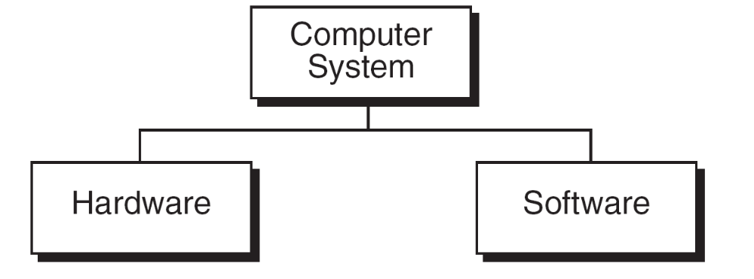
A Computer System

Slide 3
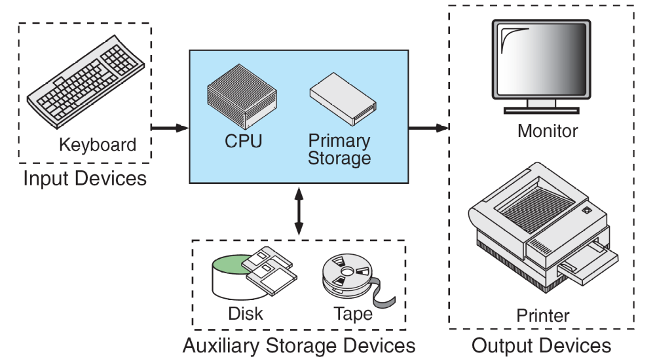
Basic Hardware Components

Slide 4
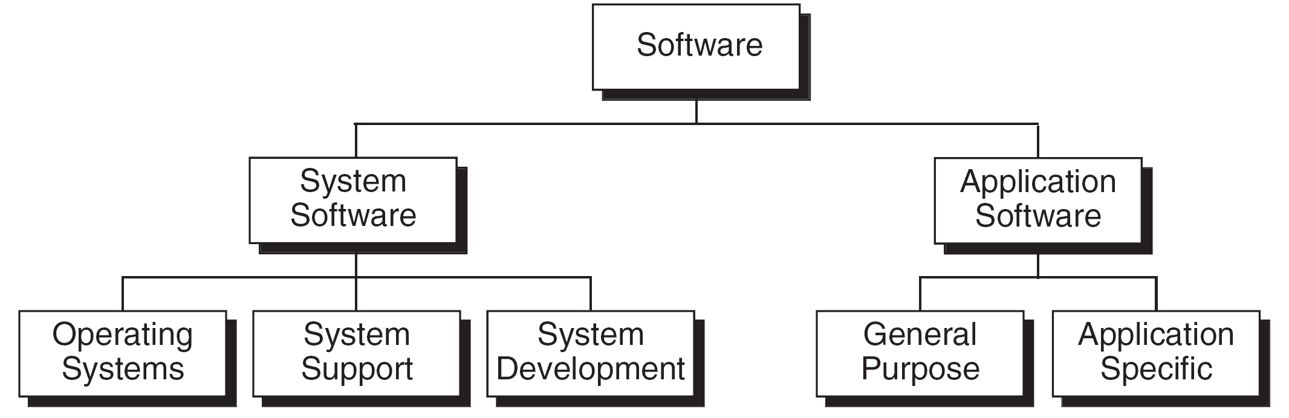
Types of Software

Slide 5
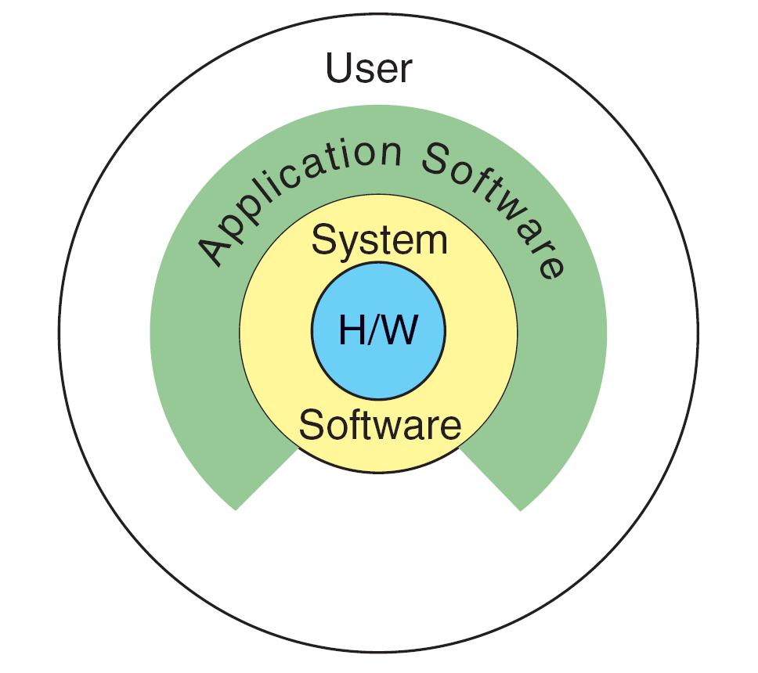
Relationship between system and application software

Slide 6
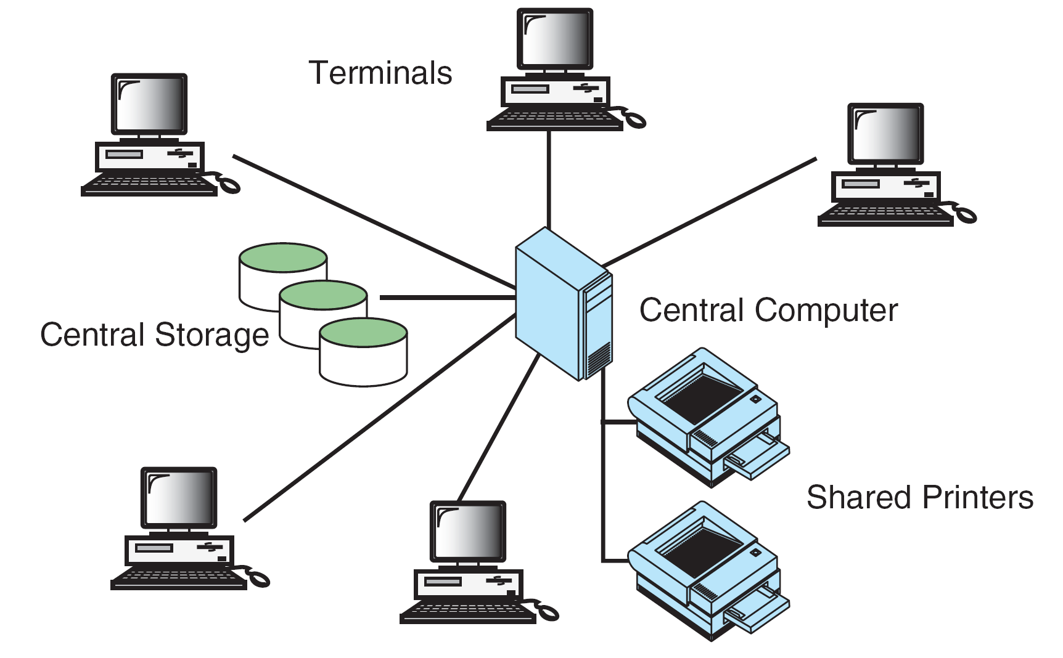
Time-sharing Environment

Slide 7
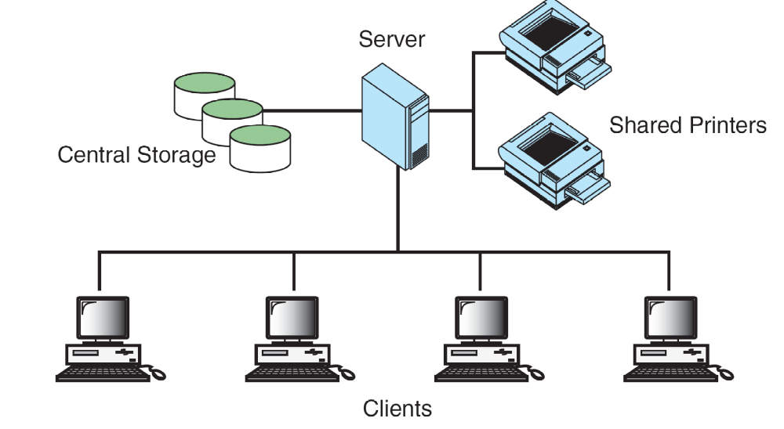
The Client/Server Environment

Slide 8
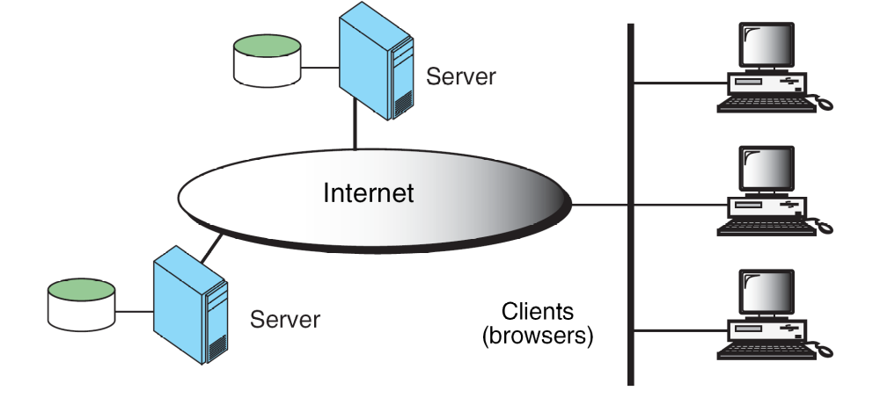
Distributed Computing

Slide 9
Computer Languages
To write a program for a computer, we must use a computer language. Over the years computer languages have evolved from machine language to natural languages.
Topics discussed in this section:
Machine Languages
Symbolic Languages
High-Level Languages

Slide 10
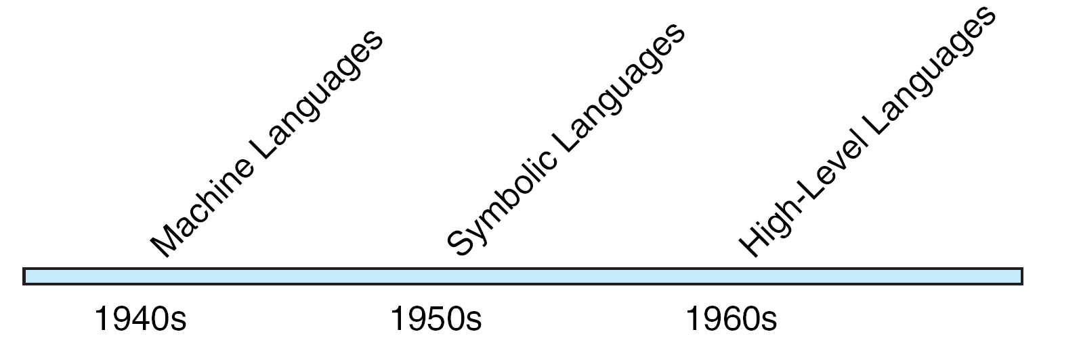
Computer Language Evolution

Slide 11
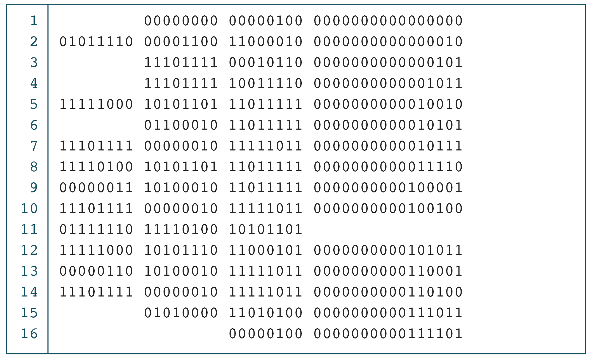
The Multiplication Program in Machine Language

Slide 12
Note
The only language understood by computer
hardware is machine language.

Slide 13
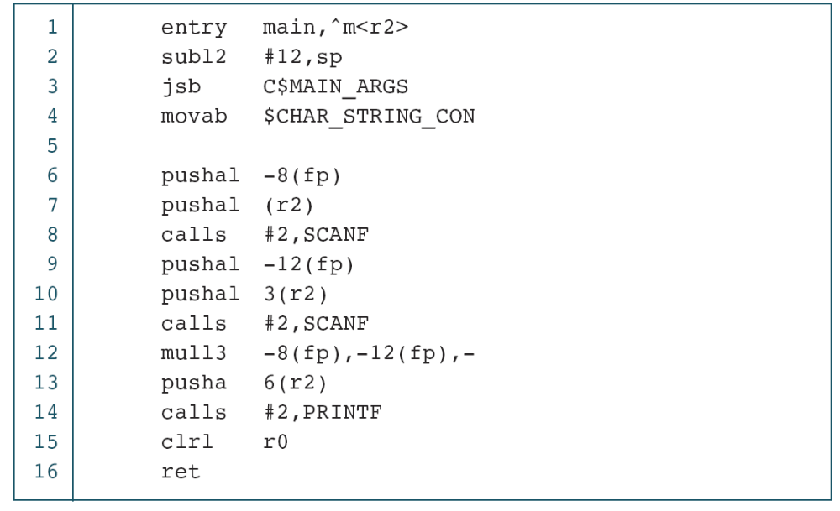
The Multiplication Program in Symbolic Language

Slide 14
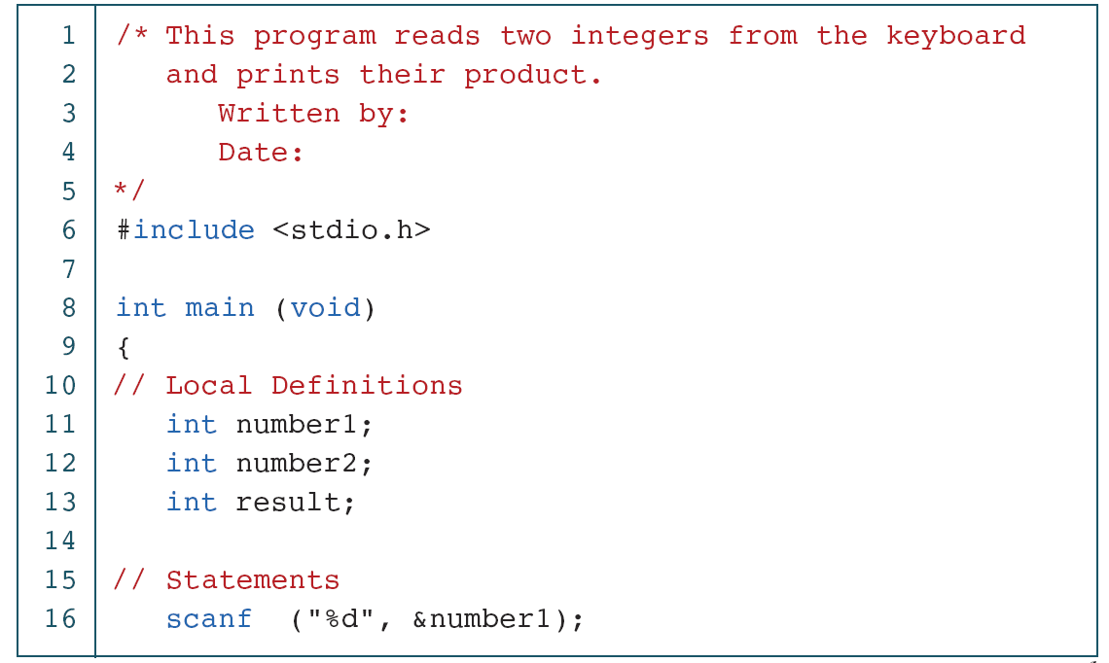
The Multiplication Program in C
continued

Slide 15
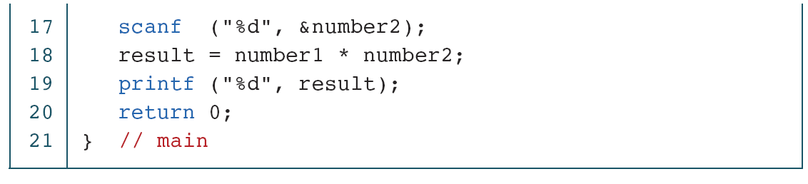
PROGRAM 1-3
The Multiplication Program in C (continued)

Slide 16
Creating and Running Programs
In this section, we explain the procedure for turning a program written in C into machine language. The process is presented in a straightforward, linear fashion, but you should recognize that these steps are repeated many times during development to correct errors and make improvements to the code.
Topics discussed in this section:
Writing and Editing Programs
Compiling Programs
Linking Programs
Executing Programs

Slide 17
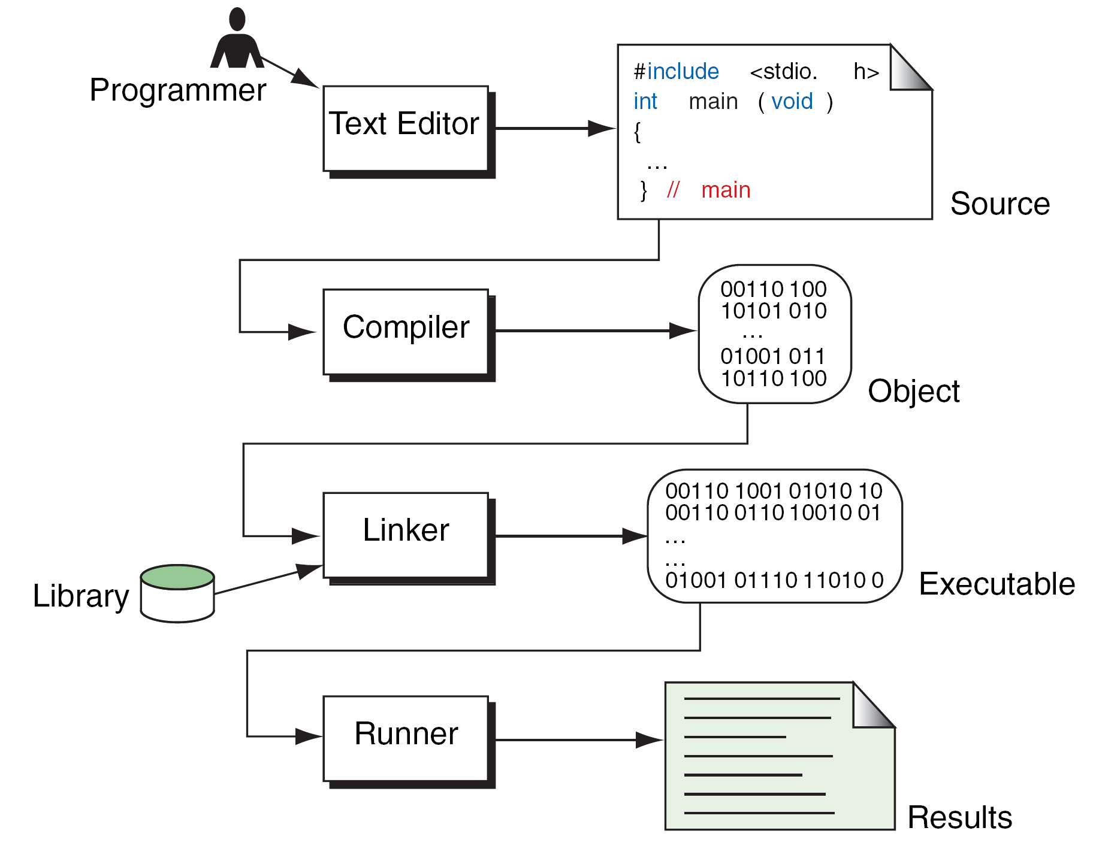
Building a C Program

Slide 18
System Development
We’ve now seen the steps that are necessary to build a program. In this section, we discuss how we go about developing a program. This critical process determines the overall quality and success of our program. If we carefully design each program using good structured development techniques, our programs will be efficient, error-free, and easy to maintain.
Topics discussed in this section:
System Development Life Cycle
Program Development

Slide 19
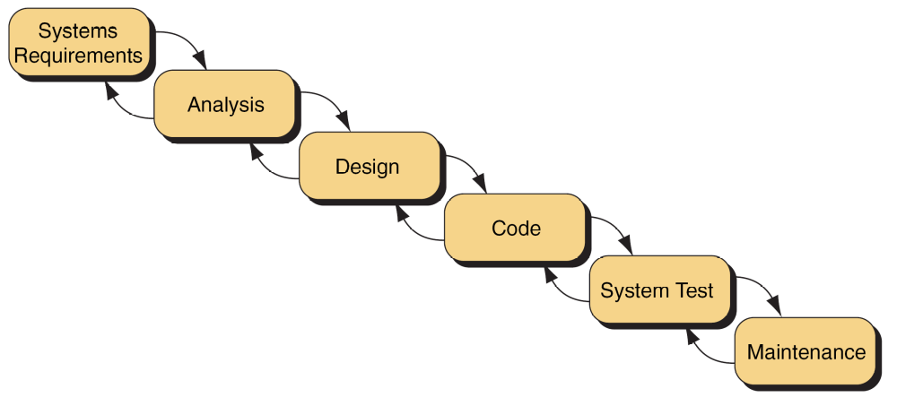
Waterfall Model

Slide 20
Note
Except for the most simple program, one set of
test data will not completely validate a program.

Slide 21
The C Programming Language
Developed by Dennis Ritchie at AT&T Bell Laboratories in the early 1970s
Growth of C tightly coupled with growth of Unix: Unix was written mostly in C
Success of PCs: need of porting C on MS-DOS
Many providers of C compilers for many different platforms => need for standardization of the C language
1990: ANSI C (American National Standards Institute)
International Standard Organization: ISO/IEC 9899:1990
1999: standard updated: C99, or ISO/IEC 9899:1999

Slide 22
The first C program
uses standard library
input and output functions
(printf)
#include <stdio.h>
int main (void)
{
printf ("Programming is fun.\n");
return 0;
}
the program
begin of program
statements
end of program
main: a special name that indicates where the program must begin execution. It is a special function.
first statement: calls a routine named printf, with argument the string of characters “Programming is fun \n”
last statement: finishes execution of main and returns to the system a status value of 0 (conventional value for OK)

Slide 23
The format in C
Statements are terminated with semicolons
Indentation is nice to be used for increased readability.
Free format: white spaces and indentation is ignored by compiler
C is case sensitive – pay attention to lower and upper case letters when typing !
  All C keywords and standard functions are lower case
  Typing INT, Int, etc instead of int is a compiler error
Strings are placed in double quotes
New line is represented by \n (Escape sequence)

Slide 24
Compiling and running C programs
Editor
Source code
file.c
Compiler
Object code
file.obj
Libraries
Linker
Executable code
file.exe
IDE (Integrated Development Environment)

Slide 25
C Compilers and IDE’s
One can:
  use a text editor to edit source code, and then use independent command-line compilers and linkers
  use an IDE: everything together + facilities to debug, develop and organize large projects
There are several C compilers and IDE’s that support various C compilers (You may consider MinGW GCC, VS CODE)
Dev-C++ IDE for C and C++, Free Software (under the GNU General Public License)
  Works with gcc (GNU C Compiler)
    supports the C99 standard
    available on Windows and Unix
  The GNU Project (http://www.gnu.org/): launched in 1984 in order to develop a complete Unix-like operating system which is free software - the GNU system.

Slide 26
Debugging program errors
Editor
Syntactic
Errors
Source code
file.c
Compiler
Object code
file.obj
Libraries
Linker
Executable code
file.exe
Semantic
Errors

Slide 27
Syntax and Semantics
Syntax errors: violation of programming language rules (grammar)
  "Me speak English good."
  Use valid C symbols in wrong places
  Detected by the compiler
Semantics errors: errors in meaning:
  "This sentence is excellent Italian."
  Programs are syntactically correct but don’t produce the expected output
  User observes output of running program

Slide 28
Second program
#include <stdio.h>
int main (void)
{
printf ("Programming is fun.\n");
printf ("And programming in C is even more fun.\n");
return 0;
}

Slide 29
Displaying multiple lines of text
#include <stdio.h>
int main (void)
{
printf ("Testing...\n..1\n...2\n....3\n");
return 0;
}
It is not necessary to make a separate call to printf for each line of output !
Output:
Testing...
..1
...2
....3

Slide 30
Variables
Programs can use symbolic names for storing computation data and results
Variable: a symbolic name for a memory location
  programmer doesn’t has to worry about specifying (or even knowing) the value of the location’s address
In C, variables have to be declared before they are used

Slide 31
Using and Displaying Variables
#include <stdio.h>
int main (void)
{
int sum;
sum = 50 + 25;
printf ("The sum of 50 and 25 is %i\n", sum);
return 0;
}
Variable sum declared of type int
Variable sum assigned expression 50+25
Value of variable sum is printed in place of %i
The printf routine call has now 2 arguments: first argument a string containing also a format specifier (%i), that holds place for an integer value to be inserted here

Slide 32
Displaying multiple values
#include <stdio.h>
int main (void)
{
int value1, value2, sum;
value1 = 50;
value2 = 25;
sum = value1 + value2;
printf ("The sum of %i and %i is %i\n",value1, value2, sum);
return 0;
}
The format string must contain as many placeholders as expressions to be printed

Slide 33
Using comments in a program
Comment statements are used in a program to document it and to enhance its readability.
Useful for human readers of the program – compiler ignores comments
Ways to insert comments in C:
  When comments span several lines: start marked with /*, end marked with */
  Comments at the end of a line: start marked with //

Slide 34
Using comments in a program
/* This program adds two integer values
and displays the results */
#include <stdio.h>
int main (void)
{
  // Declare variables
  int value1, value2, sum;
  // Assign values and calculate their sum
  value1 = 50;
  value2 = 25;
  sum = value1 + value2;
  // Display the result
  printf ("The sum of %i and %i is %i\n",
  value1, value2, sum);
  return 0;
}

Slide 35
